Slide 1
BIT 353 ARTIFICIAL INTELLIGENCE
Lecturer: Saroj Poudel
Qualification: MS CIS&IT
Profession: Senior Software Developer/CTO
Lincoln University College, CN 1221

Slide 2


Overview
The subject will cover the foundations of modern artificial intelligence (AI) and many of the key ideas that have resonated throughout its history.
It will focus on concepts that are not only important in the space of AI but are also practically useful in modern applications.
We will practice effective methods of reasoning about AI problems, which will generalize beyond the specific topics we study in class.

Slide 3
What are we learning?
Introduction to AI
Why AI in today’s tech world
Definition of AI
Characteristics of AI
History of AI
Application of AI
Some Terminology of AI

Slide 4
Intelligence
The ability to reason
The ability to understand
The ability to create
The ability to Learn from experience
The ability to plan and execute complex tasks

Slide 5
The intelligent behavior may include
Everyday Tasks:
recognize a friend, recognize who is calling, translate from one language to
another, interpret a photograph, talk, and cook a dinner
Formal Tasks:
prove a logic theorem, geometry, calculus, play chess, checkers, or Go
Expert Tasks:
engineering design, medical designers, financial analysis

Slide 6
Artificial Intelligence
AI is the branch of computer science concerned with making computers behave like humans.
AI is the science and engineering of making intelligent machines, especially intelligent computer programs.
The process may include:
Learning (Gaining of information and rules for using the information.
Reasoning (Using the rules to reach approximate or definite conclusions).
Self-Correction

Slide 7
According to Barr and Feigenbaum
“Artificial Intelligence is the part of computer science concerned with designing intelligence computer systems that is, systems that exhibit the characteristics we associate with intelligence in human behavior.”

Slide 8
According to Elaine Rich
“AI is the study of how to make computers do things at which, at the moment, people are better”

Slide 9
An AI system should have
Capability to provide reason about something
Capability of natural language processing
Capability of learning past experience
Capability of self-correction

Slide 10
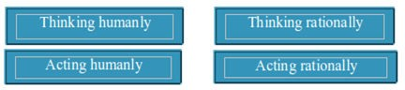
Approach / View of AI fall into four categories

Slide 11
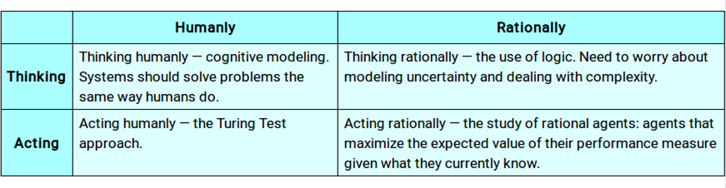

Slide 12
The Turing Test approach
The Turing Test is a method for determining whether or not a computer is capable of thinking like a human.
The test is name after Alan Turing, an English Mathematician who pioneered artificial intelligence during the 1940s and 1950s, and who is credited with devising the original version of the test.
According to this kind of test, a computer is deemed to have artificial intelligence if it can mimic human responses under specific conditions.

Slide 13
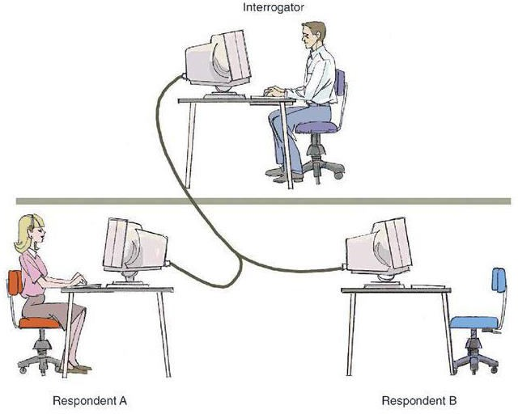

Slide 14
Consider the following setting:
There are two rooms, A and B. One of the rooms contains a computer. The other contains a human. The interrogator is outside and does not know which one is computer. He can ask questions through teletype and receives answers from both A and B.
The interrogator needs to identify whether A or B are humans. To pass the Turing test, the machine has to fool the interrogator into believing that it is human.

Slide 15
To pass a Turing test, a computer must have following capabilities:
Natural Language Processing :
Must be able to communicate in English successfully
Knowledge representation :
To store what it knows and hears.
Automated reasoning :
Answer the Questions based on the stored information.
Machine learning :
Must be able to adapt in new circumstances

Slide 16
On one side of the argument, human-like interaction is seen as absolutely essential to human-like intelligence. A successful AI is worthless if its intelligence lies trapped in an unresponsive program.
Turing's test deliberately avoided direct physical interaction between the interrogator and the computer, because physical simulation of a person is unnecessary for intelligence.
So, total Turing Test includes a video signal so that the interrogator can test the subject's perceptual abilities, as well as the opportunity for the interrogator to pass physical objects "through the hatch."
To pass the total Turing Test, the computer will need
computer vision to perceive objects, and
robotics to move them about

Slide 17
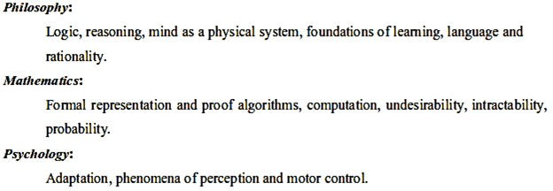
AI and related fields

Slide 18
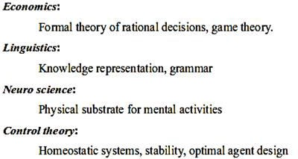

Slide 19
Brief History of AI
The term “Artificial Intelligence” was used for the first time in 1956 by an American scientist John McCarthy who is referred to as the Father of AI.
McCarthy also come up with a programming language called LISP (i.e. List- Processing), which is still used to program computer in AI that allow the computer to learn.
Further, the major achievements can be listed as below:

Slide 20
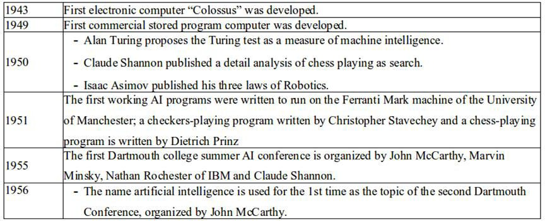

Slide 21
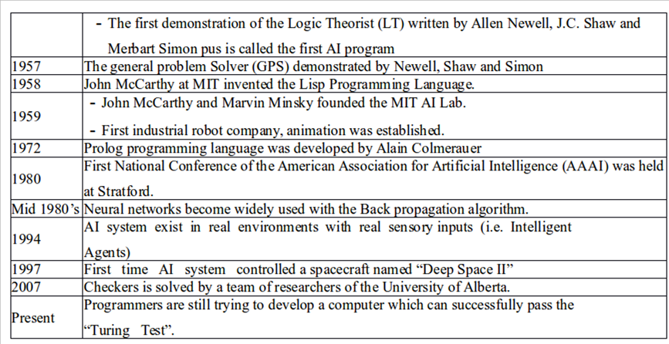

Slide 22
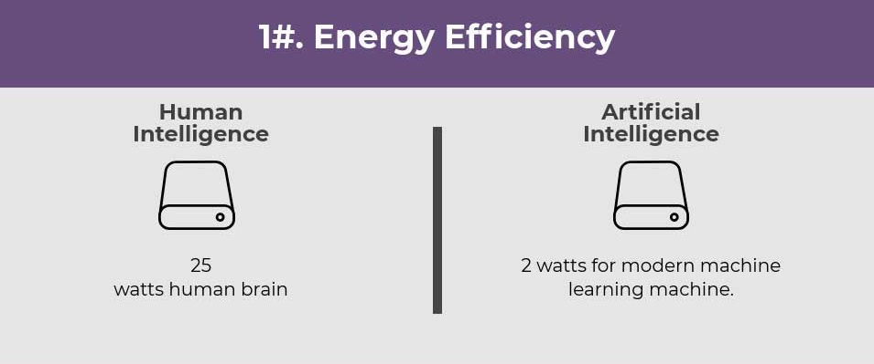
Human Intelligence vs Artificial Intelligence

Slide 23
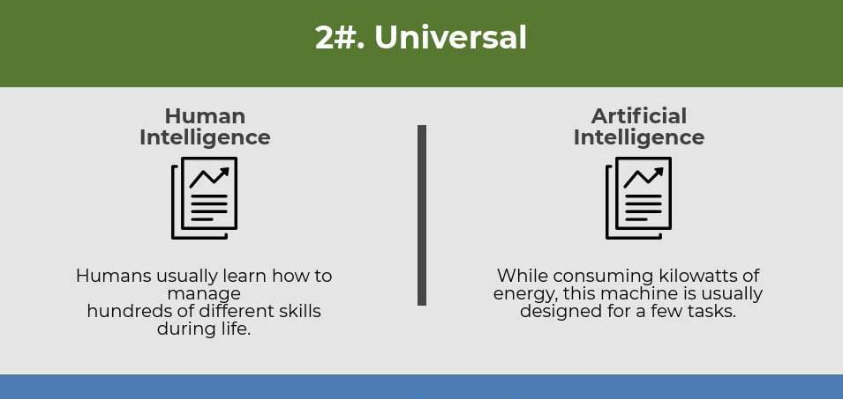
Human Intelligence vs Artificial Intelligence

Slide 24
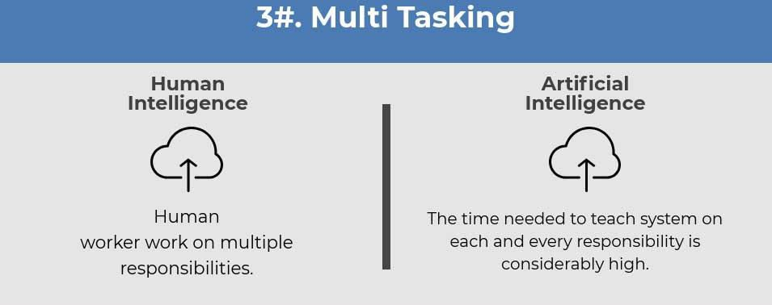
Human Intelligence vs Artificial Intelligence

Slide 25
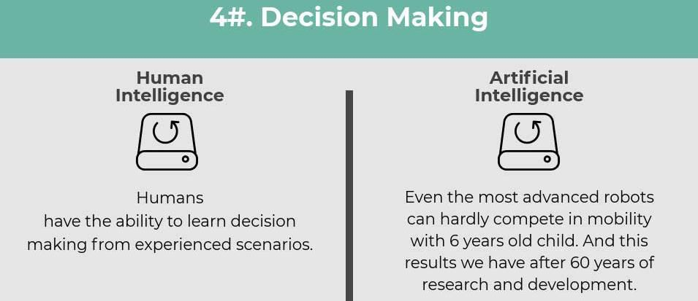
Human Intelligence vs Artificial Intelligence

Slide 26
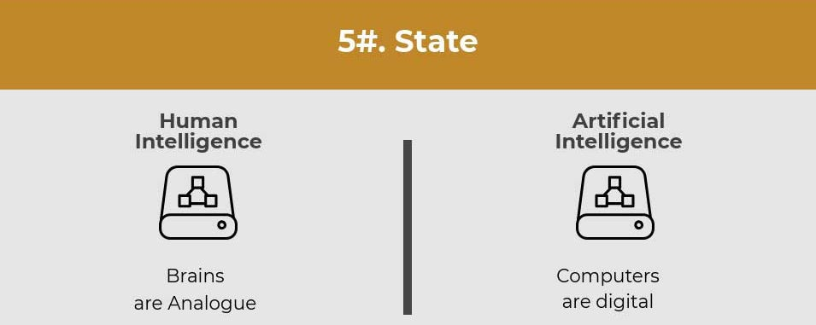
Human Intelligence vs Artificial Intelligence

Slide 27
Application of AI
Artificial intelligence has been used in a wide range of fields including medical diagnosis, stock trading, robot control, law, remote sensing, scientific discovery and toys.
Many thousands of AI applications are deeply embedded in the infrastructure of every industry.
In the late 90s and early 21st century, AI technology became widely used as elements of larger systems, but the field is rarely credited for these successes

Slide 28
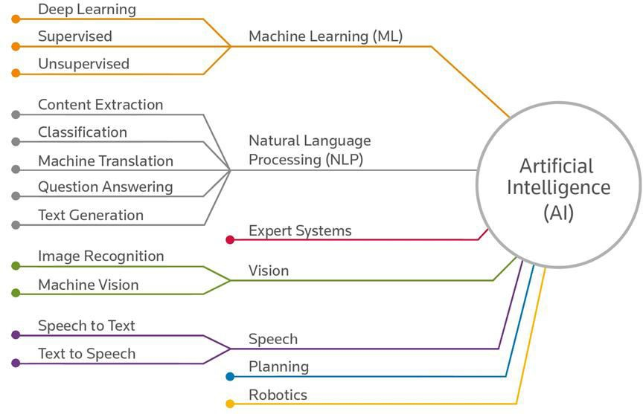

Slide 29
Game Playing
Machines can play master level chess. There is some AI in them, but they well against people mainly through brute force method, looking at hundreds of thousands of positions.
Speech Recognition
It is possible to instruct some computers using speech. In 1990s, computer speech recognition reached a practical level for limited purposes.
Understanding Natural Language
To perform many natural language processing tasks such as machine translation, summarization, information extraction, word sense disambiguation summarization, information extraction, word sense disambiguation need the AI in machine.

Slide 30
Computer Vision
Computer vision is concerned with the theory behind artificial system that extract information from images. The image data can take many forms such as videos sequences views from multiple cameras and data from a medical scanner.
Expert System
Expert system needs the AI to perform its task. One of the first expert system was MYCIN 1974 which diagnosis bacterial infections of the blood and suggests treatments.
Finance
Financial institutions have long used artificial neural network systems to detect charges or claims outside of the norm, flagging these for human investigation. Use of AI in banking can be traced back to 1987 when Security Pacific National Bank in USA set-up a Fraud Prevention Task force to counter the unauthorized use of debit cards.

Slide 31
Hospitals and medicine
Artificial neural networks are used as clinical decision support systems for medical diagnosis, such as in Concept Processing technology. Other tasks in medicine that can potentially be performed by artificial intelligence include:
Computer-aided interpretation of medical images. Such systems help scan digital images, e.g. from computed tomography, for typical appearances and to highlight conspicuous sections, such as possible diseases.
detection of a tumor.
Heart sound analysis
Companion robots for the care of the elderly

Slide 32
Music
The evolution of music has always been affected by technology. With AI, scientists are trying to make the computer emulate the activities of the skillful musician. Composition, performance, music theory, sound processing are some of the major areas on which research in Music and Artificial Intelligence are focusing.
Aviation
The Air Operations Division (AOD) uses AI for the rule based expert systems. The AOD has use for artificial intelligence for replacement operators for fighting and training simulators, mission management aids, support systems for tactical decision making, and post processing of the simulator data into symbolic memories.

Slide 33
Ethical issues in Artificial Intelligence
Unemployment.
What happens after the end of jobs?
Humanity.
How do machines affect our behavior and interaction?
Racist robots.
How do we eliminate AI bias?
Security.
How do we keep AI safe from adversaries?
Singularity.
How do we stay in control of a complex intelligent system?

Slide 34
End of Chapter 1
Thank you

